Slide 1
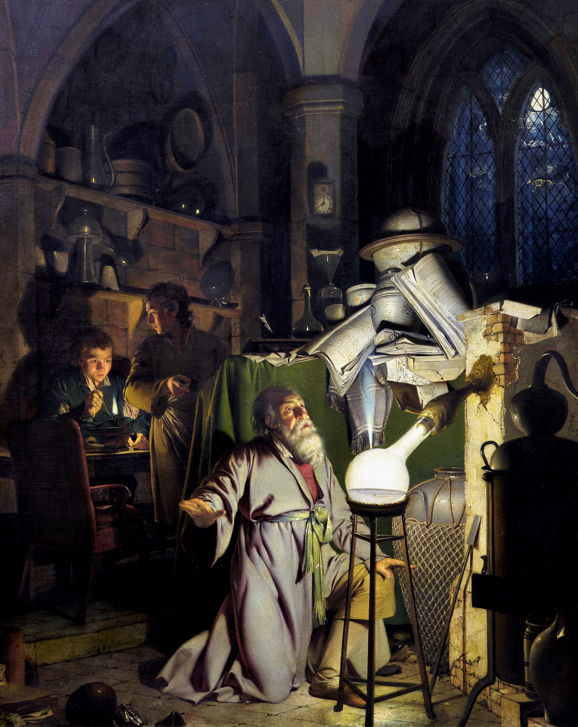

Intro, or: Why Science rulez (sometimes)
IL “Scientific Method and Analysis” WS 25-26
Kami Höferl
(Wright of Derby , Wikimedia, PD)
Notes:
"The Alchemist in Search of the Philosopher’s Stone" by Joseph Wright of Derby (1771)
substance capable of turning base metals such as mercury into gold or silver[
In this work, Wright captures an alchemist conducting an experiment with a crucible in search of the philosopher’s stone. The painting portrays a moment of discovery and highlights the experimental process central to early chemistry, before the formalization of modern science.

Slide 2
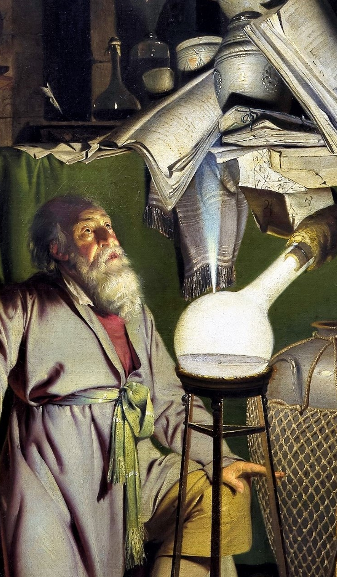
Overview
A look in the syllabus
Science is …?
… a process
… a body of knowledge
… a social institution

Slide 3
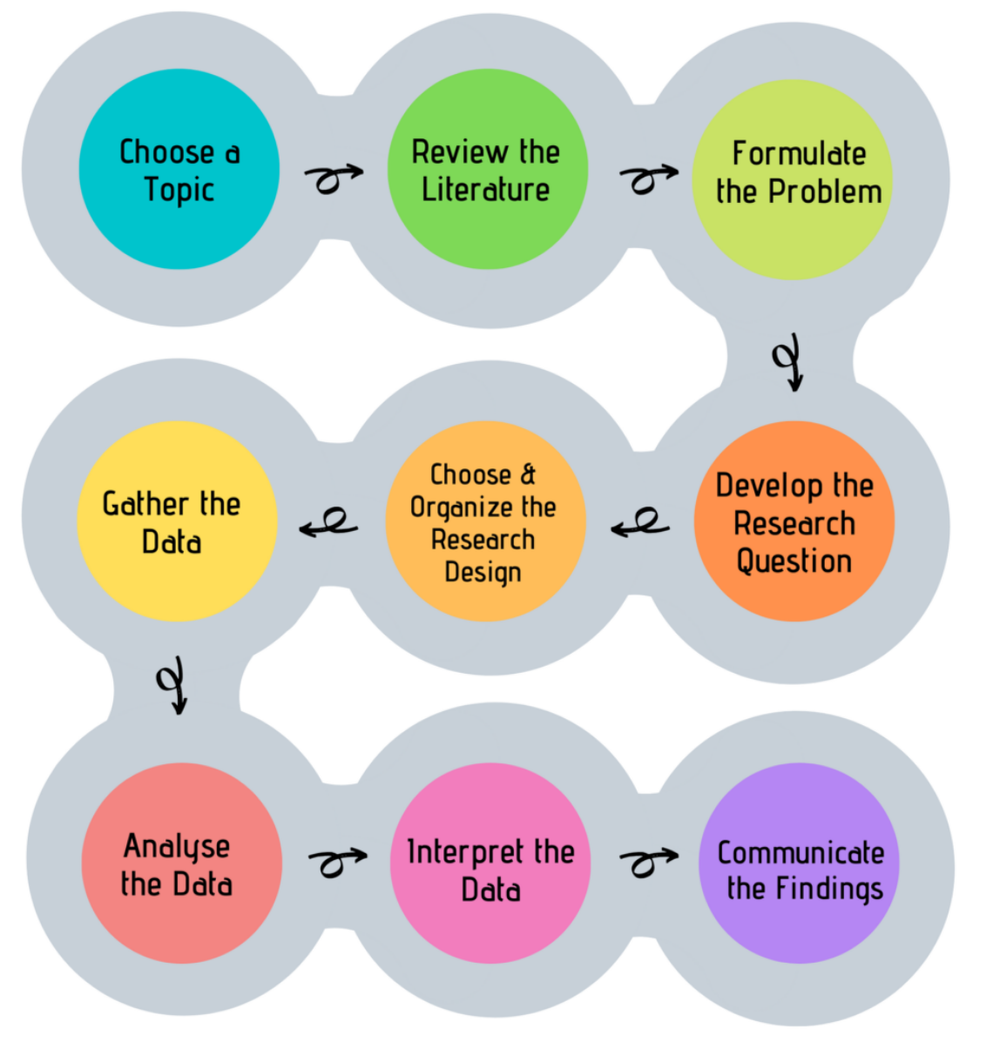
Look, Think, Test, Tell
👉 Main goal:
Understand scientific method

Slide 4
Science?

Slide 5
Science?
🤔

Slide 6
Science is not …
collecting facts or information with no clear purpose.
reassembling and reordering facts or information without interpretation.
an activity with no or little relevance to everyday life.
a term to get your product or idea noticed and respected.
…

Slide 7
Science is …

Slide 8
Science is …
“… the pursuit and application of knowledge and understanding of the natural and social world following a systematic methodology based on evidence.” (Science Council, 2009)

Slide 9
Science is …
“any system of knowledge that is concerned with the physical world and its phenomena and that entails unbiased observations and systematic experimentation. In general, a science involves a pursuit of knowledge covering general truths or the operations of fundamental laws.” (Brittanica, 2024)
“Science is a systematic discipline that builds and organises knowledge in the form of testable hypotheses and predictions about the world.” (Wikipedia, 2024)
…

Slide 10
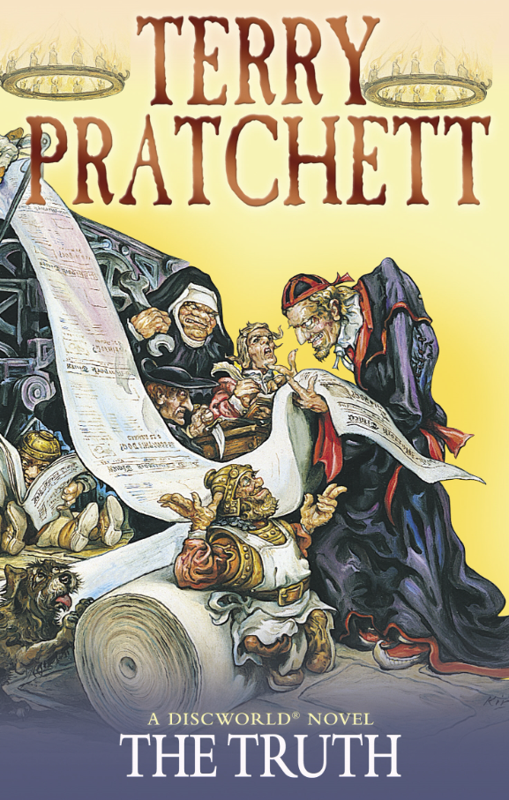
Digression: Truth in science
Scientific knowledge:
Provisional
Empiric evidence can be updated
Current best approximation of reality
Truth:
Absolute, unchanging fact / reality
In correspondence to reality / logical system
Independent of human perception / understanding

Slide 11

Digression: Truth in science
👉 Science is the graveyard of all definitive knowledge

Slide 12
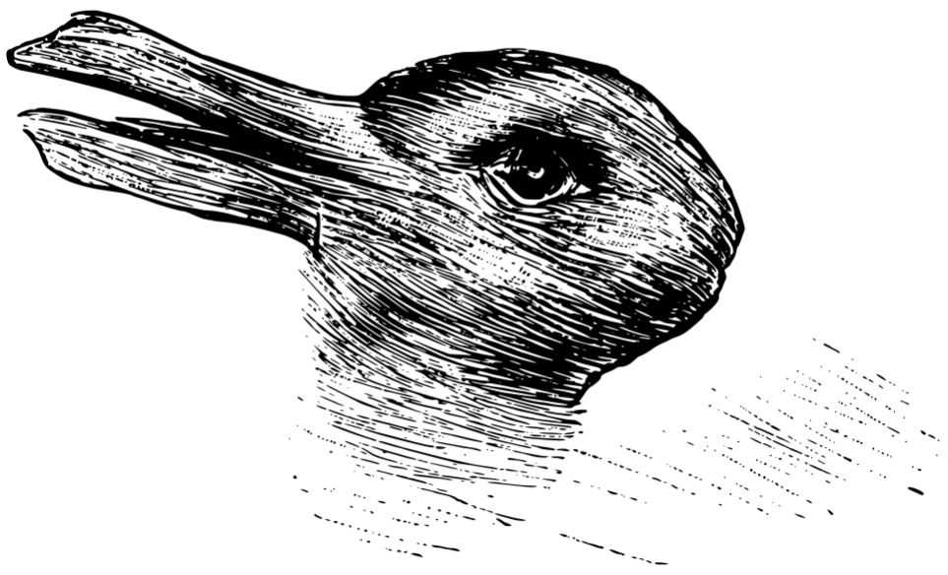
Science is …
👉 A process:
generating reliable models of the world
A body of knowledge:
collection of verified facts about the world
Social & formal Institution(s):
practices and structures (e.g. universities or research institutes) associated with conducting scientific research

Slide 13
The scientific method: Look, Think, Test, Tell

Slide 14
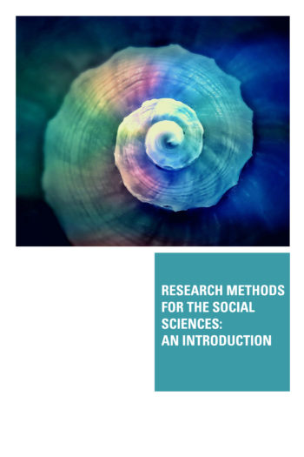
The scientific method: Look, Think, Test, Tell
🤔 + = 👍

Slide 15
Quality criteria in science
Quality Criteria
Objectivity
Honesty
Verifiability
Reliability
Validity
Comprehen-sibility
Relevance
Logical Argumen-tation
Originality
Reproduci-bility

Slide 16
Objectivity
Scientific products should be factual & unbiased 👉 neutral in presentation
"[...] the neutral attitude is a prerequisite for other people to be able to engage with the content of the work unhindered and without fear of manipulation.“ (Balzert et al. 2008:13)
👉 Self-control
Present evidence neutrally and without prejudice
Select sources impartially

Slide 17
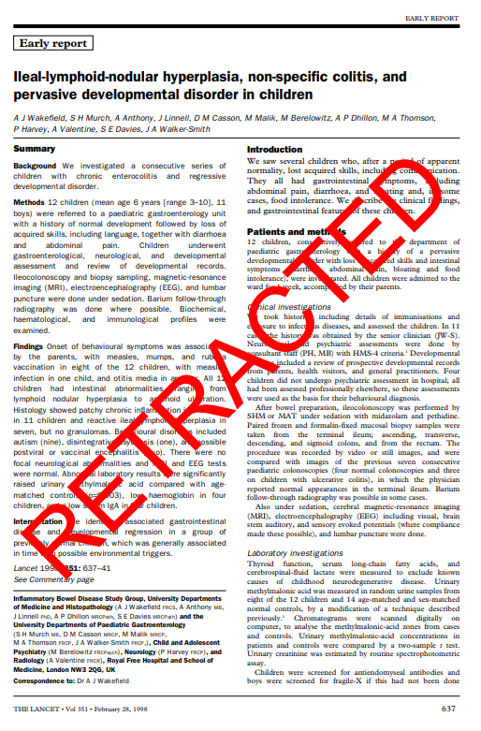
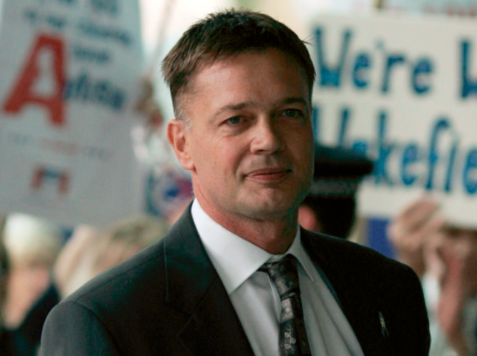
Objectivity
Wakefield’s (1999) Lancet paper on the relationship between Measles, Mumps, and Rubella (MMR) vaccination and autism

Slide 18
Reliability
"A high degree of reliability means that the measuring instruments are highly reliable and that the measurement results obtained are stable. If the examination is repeated with the same devices and methods, other people must arrive at the same results" (Balzert et al. 2008:22)
👉 “Faulty” measuring instruments:
Fluctuations
Pseudo-evidence

Slide 19
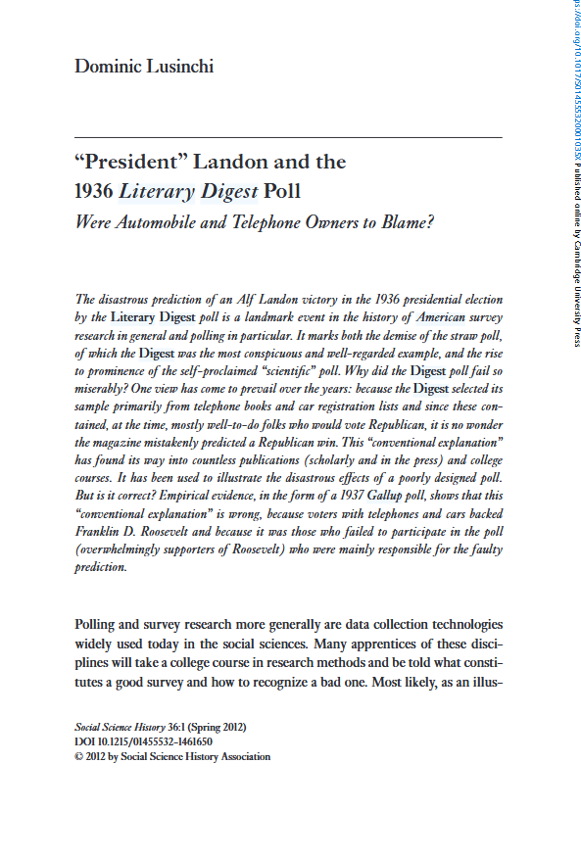
Validity
“Validity is the extent to which a concept, conclusion or measurement is well-founded and corresponds accurately to the real world” (Kimberlin & Winterstein, 2008, p. 2276).
👉 ensure that instruments, methods, and conclusions accurately represent what they are intended to measure or describe

Slide 20

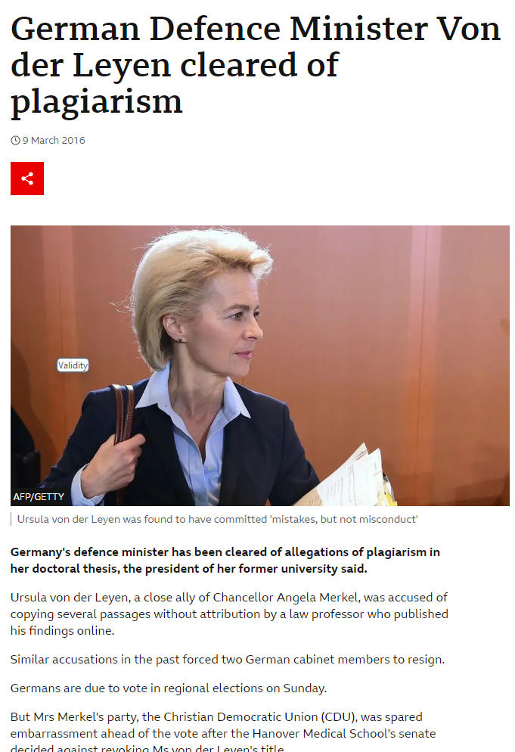
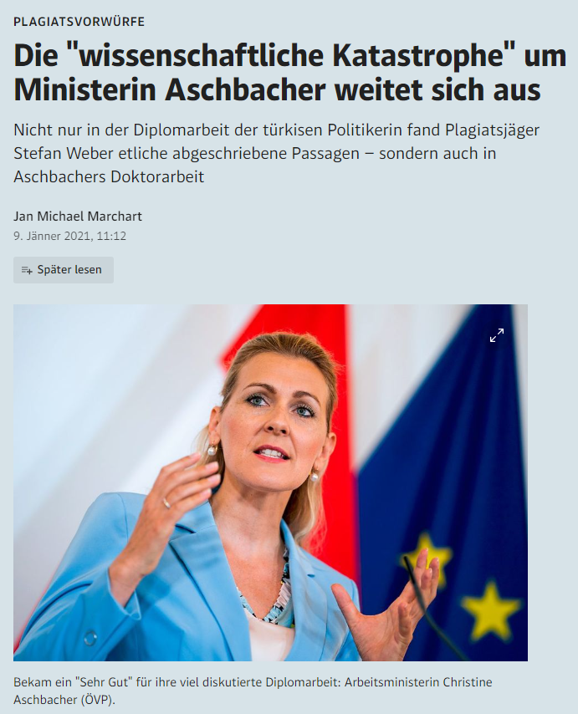
Honesty

Slide 21
Reproducibility
“Reproducibility means obtaining consistent results using the same input data, computational steps, methods, and code, and conditions of analysis” (National Academies of Sciences, Engineering, and Medicine, 2019, p. 41)
often connected to objectivity, honesty & reliability
👉 Eroding trust in scientific knowledge

Slide 22
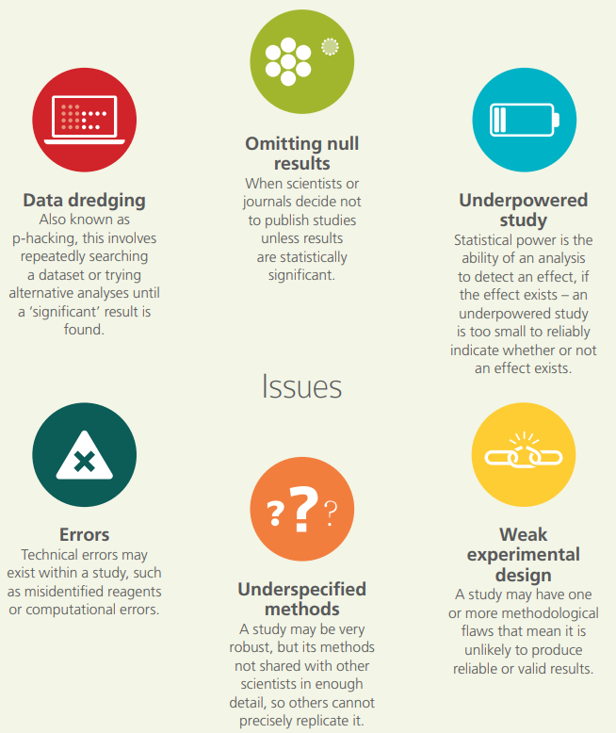
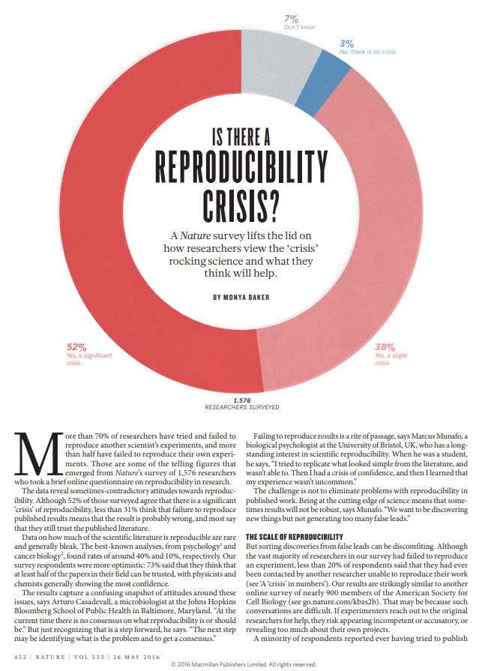
Reproducibility Crisis in Science

Slide 23
Quality criteria in science
Quality Criteria
Objectivity
Honesty
Verifiability
Reliability
Validity
Comprehen-sibility
Relevance
Logical Argumen-tation
Originality
Reproduci-bility

Slide 24
The scientific method: Look, Think, Test, Tell

Slide 25
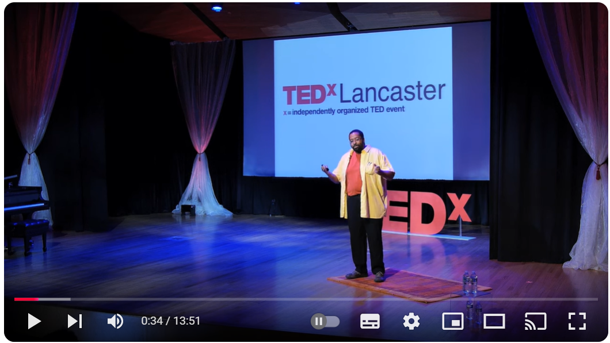
The scientific method is crap: Teman Cooke at TEDxLancaster
https://www.youtube.com/watch?v=j12BBcKSgEQ

Slide 26
Scientific Method … so it’s hot crap then?
🤔

Slide 27
Science is … a body of knowledge

Slide 28
Science is …
✅ A process:
generating reliable models of the world
👉 A body of knowledge:
collection of verified facts about the world
Social & formal Institution(s):
practices and structures (e.g. universities or research institutes) associated with conducting scientific research

Slide 29
Science as a body on knowledge?

Slide 30
Science as a body on knowledge?
Fields of scientific knowledge:
Causal explanations & descriptions of phenomena*
Foundational Concepts and Theories
Eg. Laws of Thermodynamics
Research Methodologies
Qualitative & quantitative Methods
Scientific Processes
Formation of questions & hypothesis
Experimentation
Data analysis
Peer review
Ethics & standards

Slide 31
* … knowledge ≠ knowledge
Aspect | Basic Research | Applied Research | Experimental Development
Purpose | To gain new knowledge without a specific application | To acquire knowledge aimed at solving a practical issue | To create or improve products, processes, or services
Focus | Fundamental principles and theories | Practical application and targeted outcomes | Practical implementation and optimization
Outcome | Advances in scientific understanding | Knowledge applicable to specific problems | New or improved products, processes, or services
Example Activities | Theoretical physics, exploring unknown phenomena | Developing new drug targets, market research | Prototyping, product testing, refining manufacturing

Slide 32
Science as a body on knowledge?
Sum of all formal outcomes:
Academic Publications: Peer-reviewed journals, monographs
Conferences: Oral presentations, posters, workshops
Digital Repositories: Institutional & subject-specific platforms (ResearchGate, Zenodo, arXiv etc.)
General Publications: Books, magazines, popular science
Media & Press: Press releases, science journalism, radio/TV
Public Engagement: Lectures, science fairs, outreach workshops
Education: University courses, online courses, science kits
Social Media: Blogs, Videos, podcasts
Policy Briefs: Summaries for policymakers, white papers
Industry & Non-Profits: Applied research partnerships, NGO reports

Slide 33
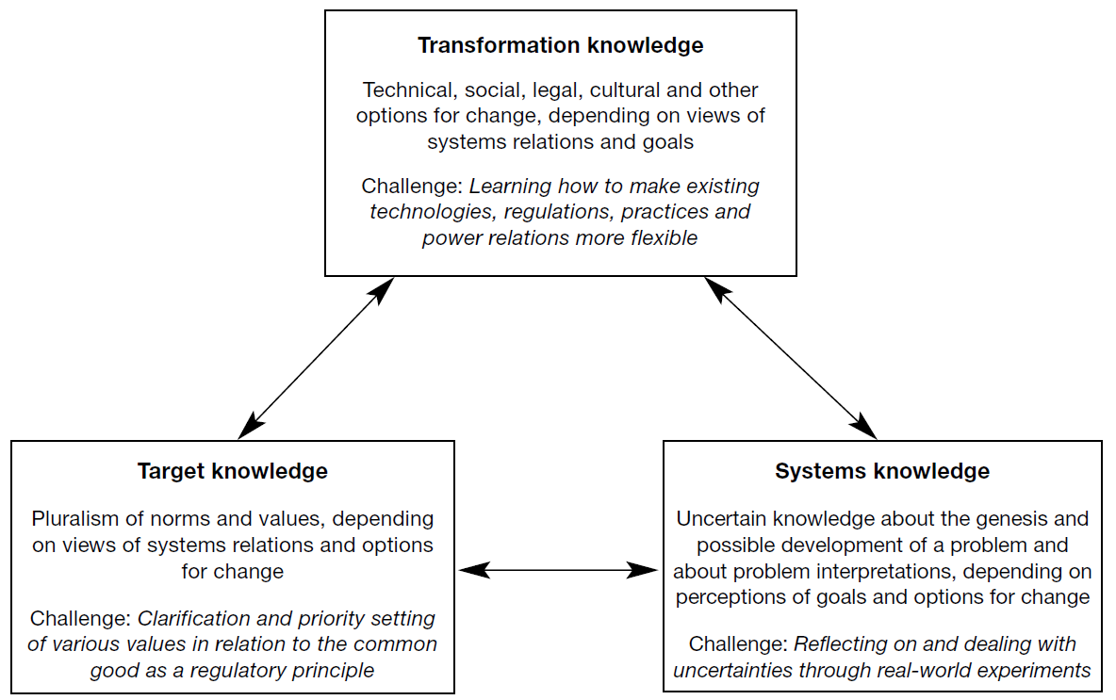
Digression: Is all knowledge the same?

Slide 34
Science is … a social institution

Slide 35
Science is …
✅ A process:
generating reliable models of the world
✅ A body of knowledge:
collection of verified facts about the world
👉 Social & formal Institution(s):
practices and structures (e.g. universities or research institutes) associated with conducting scientific research

Slide 36
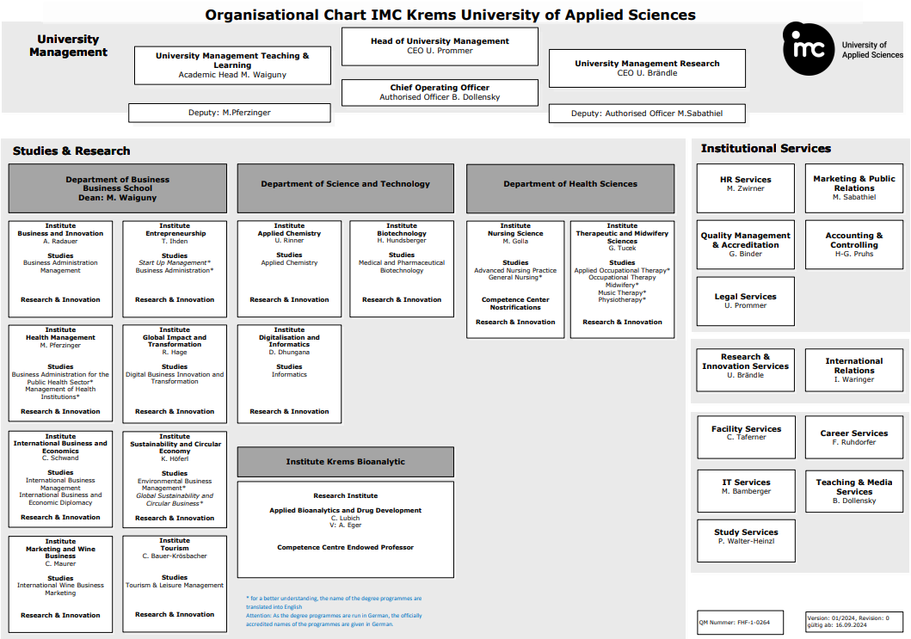

Social & formal institution(s)
Structured & enduring: Provide stability over time
Defined norms & roles: Set expectations for behaviour
Fulfils societal needs: Addresses defined functions
Shapes behaviour & beliefs: Influences values & actions
Interconnected: with other institutions
Legitimacy & authority: Accepted & respected roles in society

Slide 37
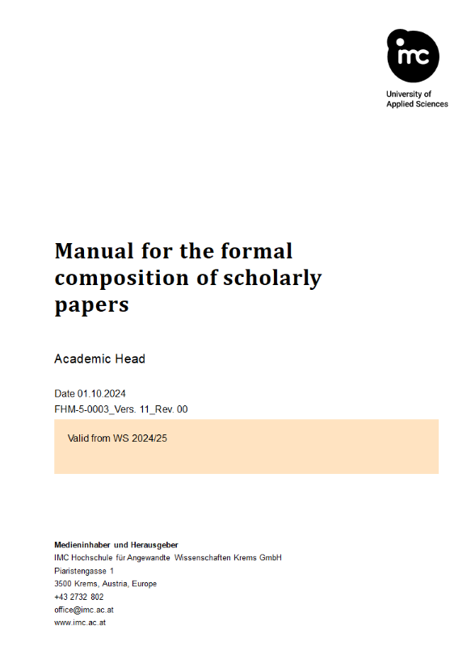

Social & formal institution(s)
Structured & enduring: Provide stability over time
Defined norms & roles: Set expectations for behaviour
Fulfils societal needs: Addresses defined functions
Shapes behaviour & beliefs: Influences values & actions
Interconnected: with other institutions
Legitimacy & authority: Accepted & respected roles in society

Slide 38
Digression: Science & society
Costs of science:
Public Universities (BMBWF, 2023):
Annual funding (2022–2024): €4.32 billion
Total allocation for 2022–2024: €12.95 billion
Universities of Applied Sciences (BMBWF, 2023):
2021 funding: €370 million
Increase to €480 million by 2026
Notes:
Universitätsfinanzierung NEU
FH-Entwicklungsplan

Slide 39
Digression: Science & society
Roles of science in society:
Advancement of knowledge: Expands understanding of the natural and social world
Drive innovation: Fuels technological and industrial progress
Improving quality of life: Leads to medical breakthroughs, better infrastructure, and solutions to global challenges.
Support economic growth: Powers industries and creates opportunities through research and development.
Informing decision-making: Provides evidence for policymaking and problem-solving
Address global challenges
Promotes critical thinking: Encourages evidence-based reasoning and scepticism
Cultivate education

Slide 40
How many “sciences” are there?

Slide 41
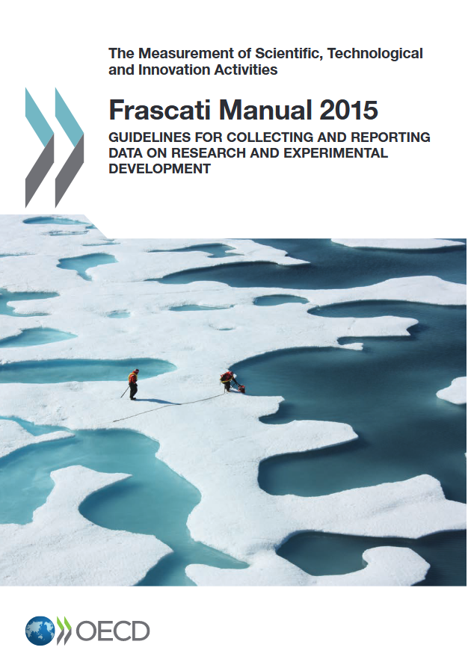
Well, a lot … (and counting 😉)
Frascati manual (2015): 6 Fields of Science & Technology
Natural Sciences (10 subcategories)
Engineering and Technology (10 subcategories)
Medical and Health Sciences (6 subcategories)
Agricultural and Veterinary Sciences (4 subcategories)
Social Sciences (9 subcategories)
Humanities and the Arts (3 subcategories)
Notes:
Not clear, how many disciplines ~ 300 to 500 and counting

Slide 42
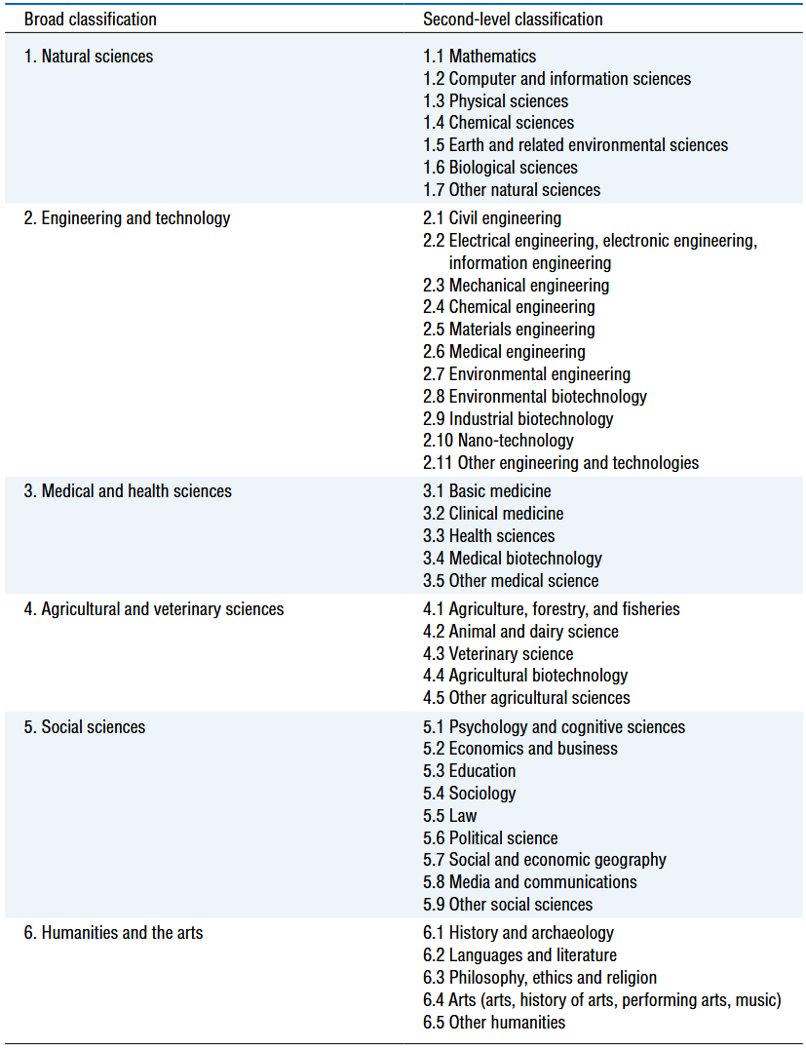
Well, a lot …
Notes:
Not clear, how many disciplines ~ 300 to 500 and counting

Slide 43
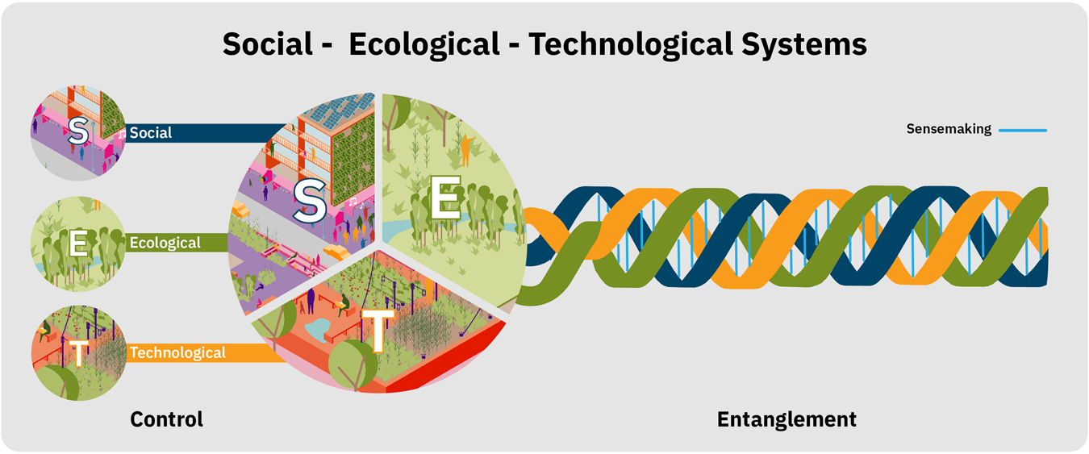
And even more …
Complex interactions 👉 new perspectives, covering many disciplines

Slide 44
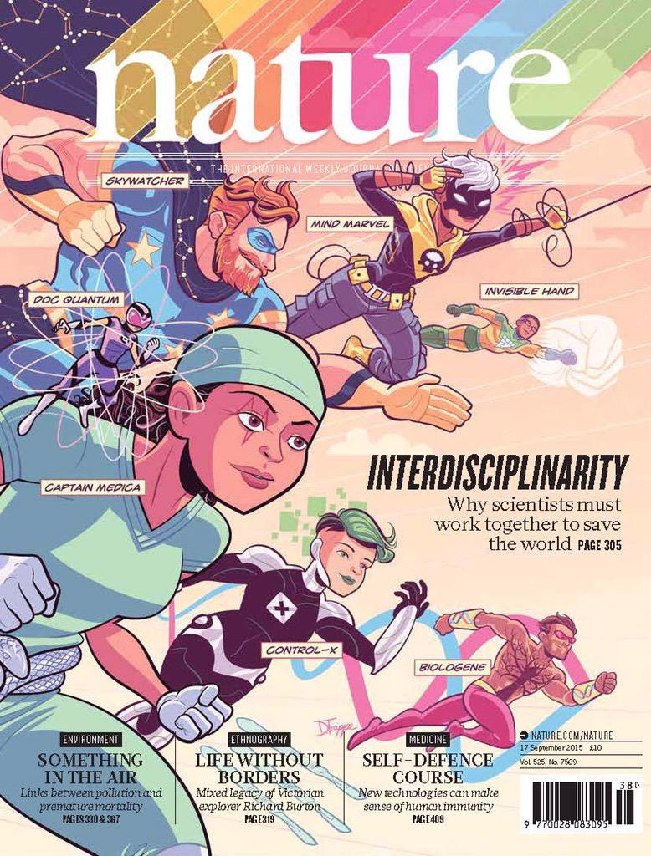
Interdisciplinarity

Slide 45
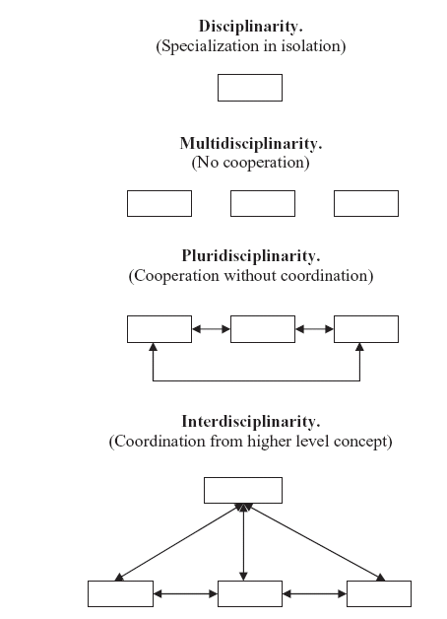
Interdisciplinarity
Interdisciplinarity (Coordination from Higher Level Concept - HLC)
Pluridisciplinarity (Cooperation without coordination)
HLC
D1
D2
D3
D1
D2
D3
D1 to D3 … disciplines

Slide 46
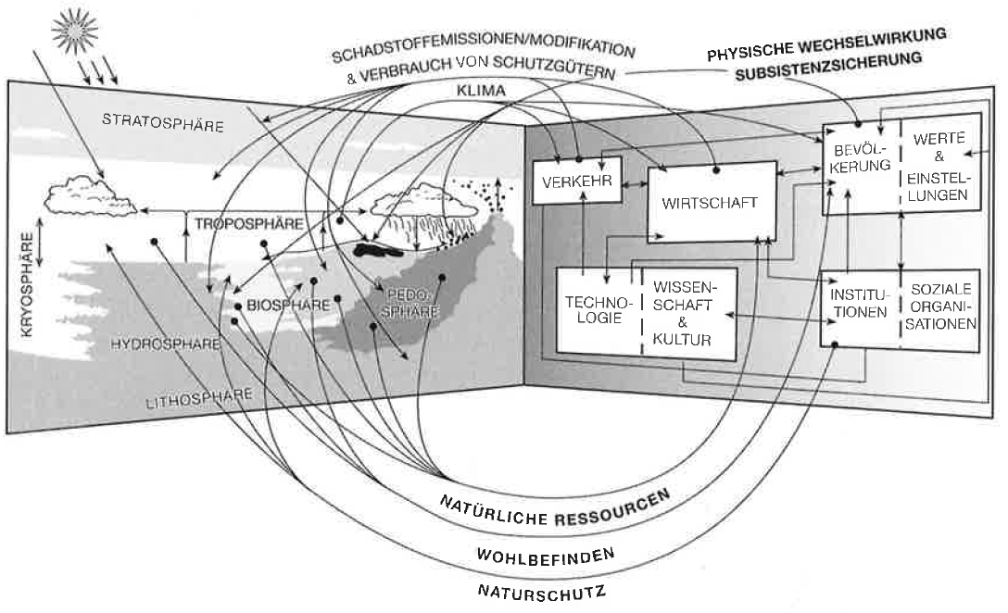
Is a single discipline enough?

Slide 47
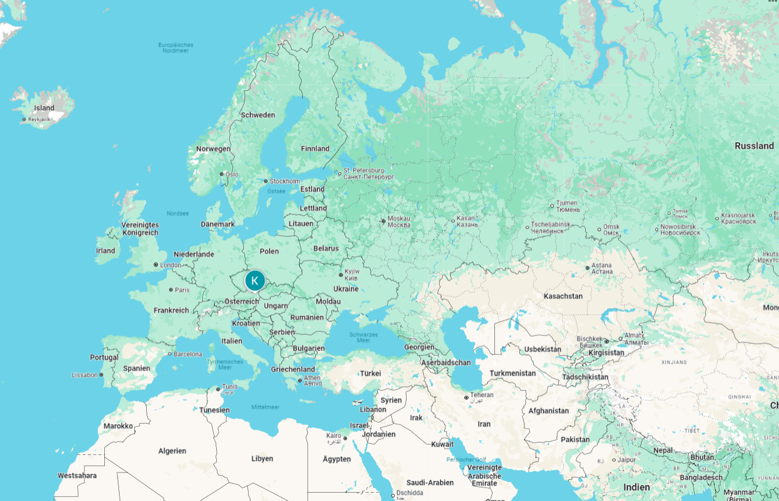

An example:

Slide 48
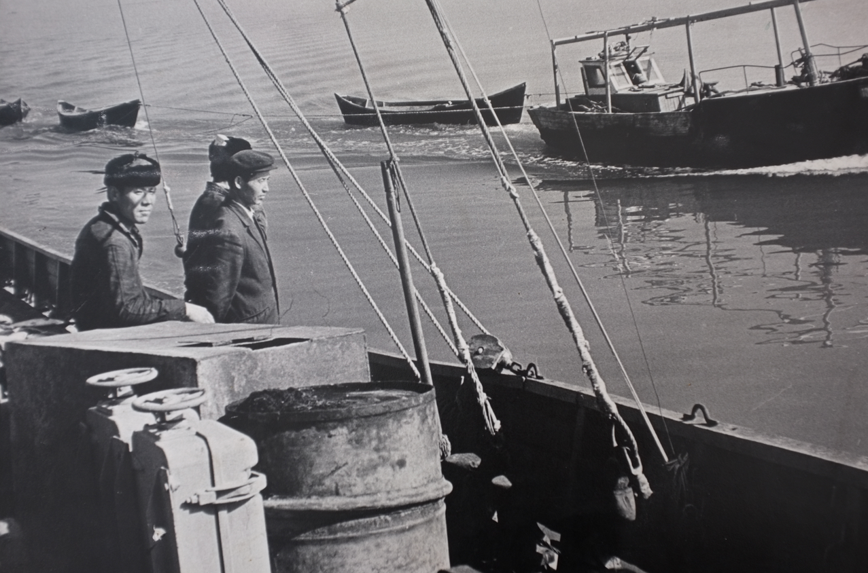
An example:

Slide 49
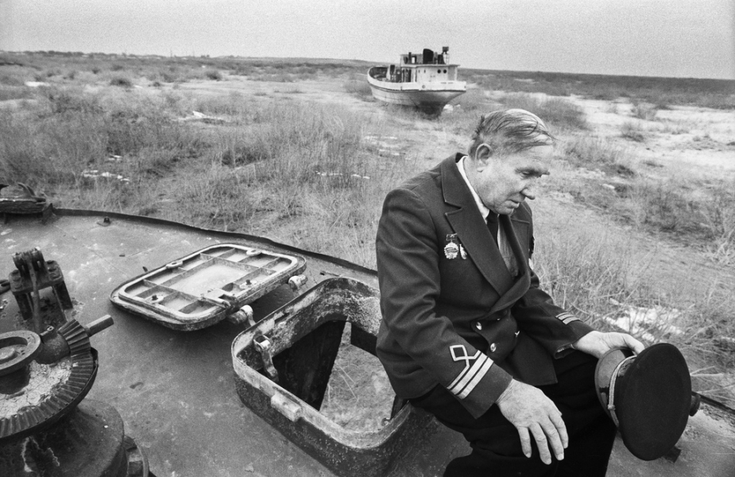
An example:

Slide 50
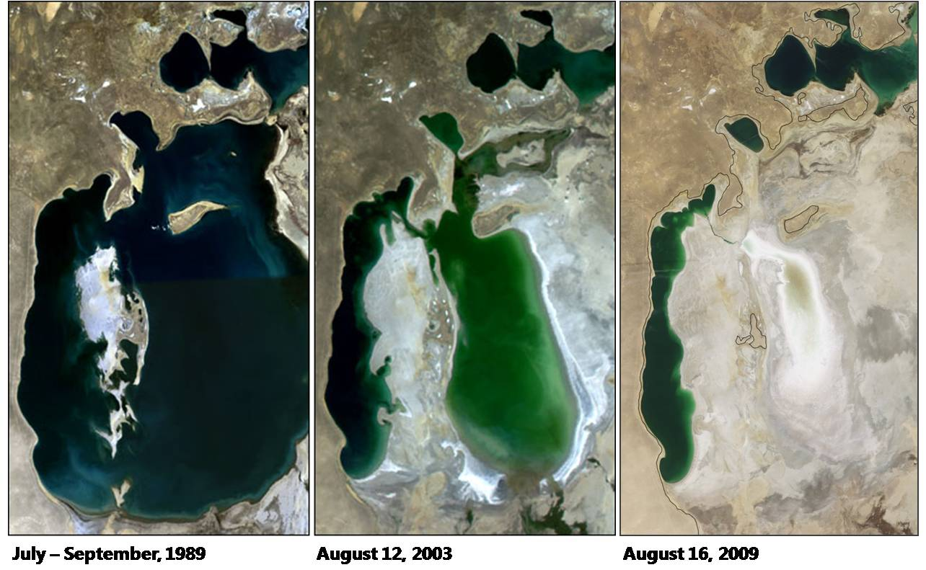
An example:

Slide 51
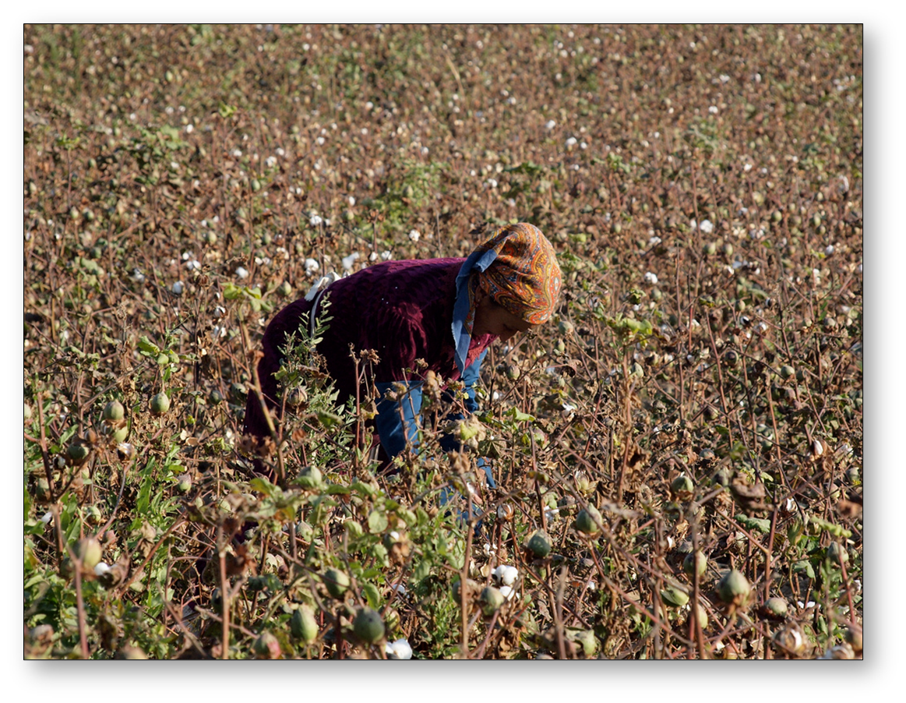
An example:
Notes:
1.47m hectares of cotton. A hugely water intensive crop, one shirt can use up to 2,700 litres.

Slide 52
Wrap it up

Slide 53
Wrap it up
Science is … the pursuit and application of knowledge and understanding of the natural and social world following a systematic methodology based on evidence
… a process 👉 „the“ scientific method
quality criteria: Validity, reproducibility, reliability, honesty etc.
… a body of knowledge
… a social institution
It can be conducted disciplinary or interdisciplinary.

Slide 54
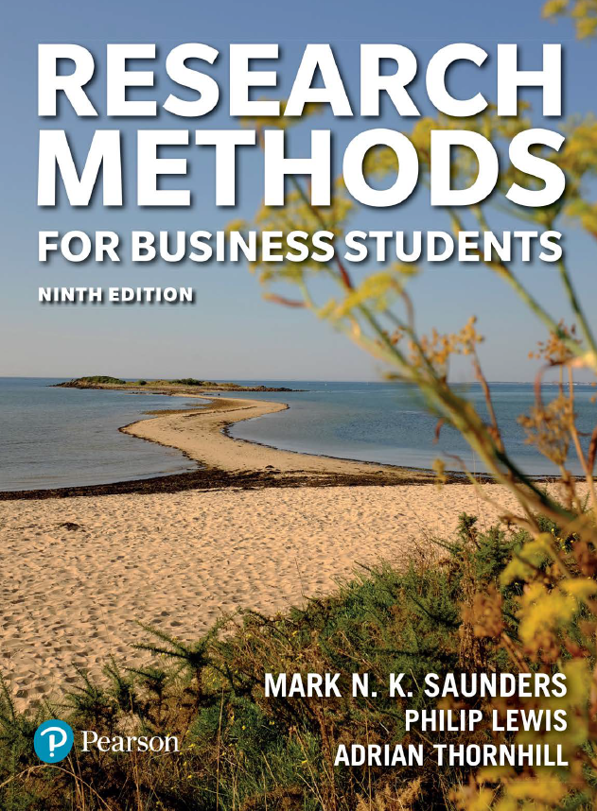
Till next session:
Chapter 2.7 “The importance of theory” from Saunders et al. (2023)

Slide 55
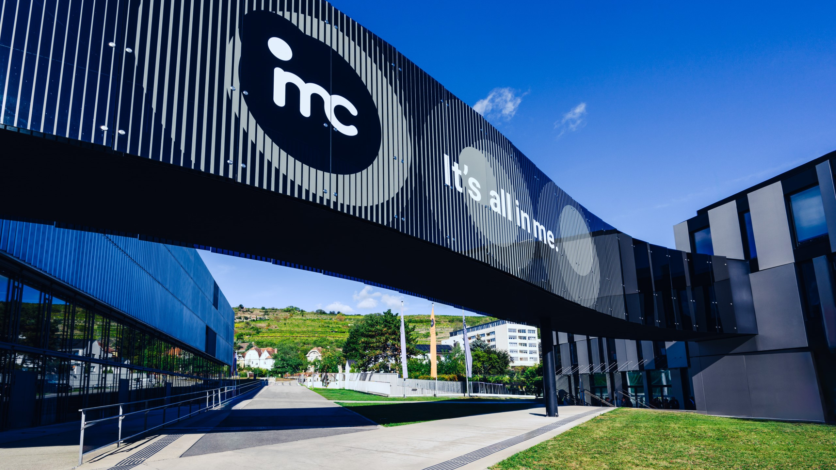
So long & cheerio!

Slide 56
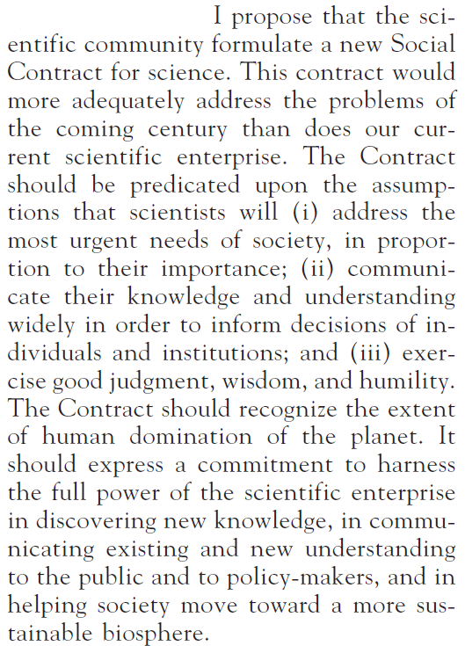
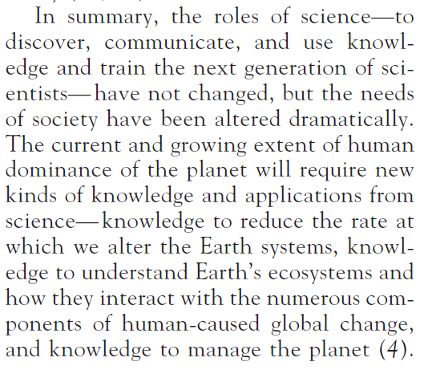
Lubchenco (1998): A new Social Contract for Science?

Slide 57
Another angle:
Basic Research:
Experimental or theoretical work to gain new knowledge
No specific practical application in mind
Applied Research:
Original investigation aimed at solving specific, practical problems
Driven by a targeted outcome or application
Experimental Development:
Systematic work based on existing knowledge
Focused on creating or improving products, processes, or services

